Slide 1
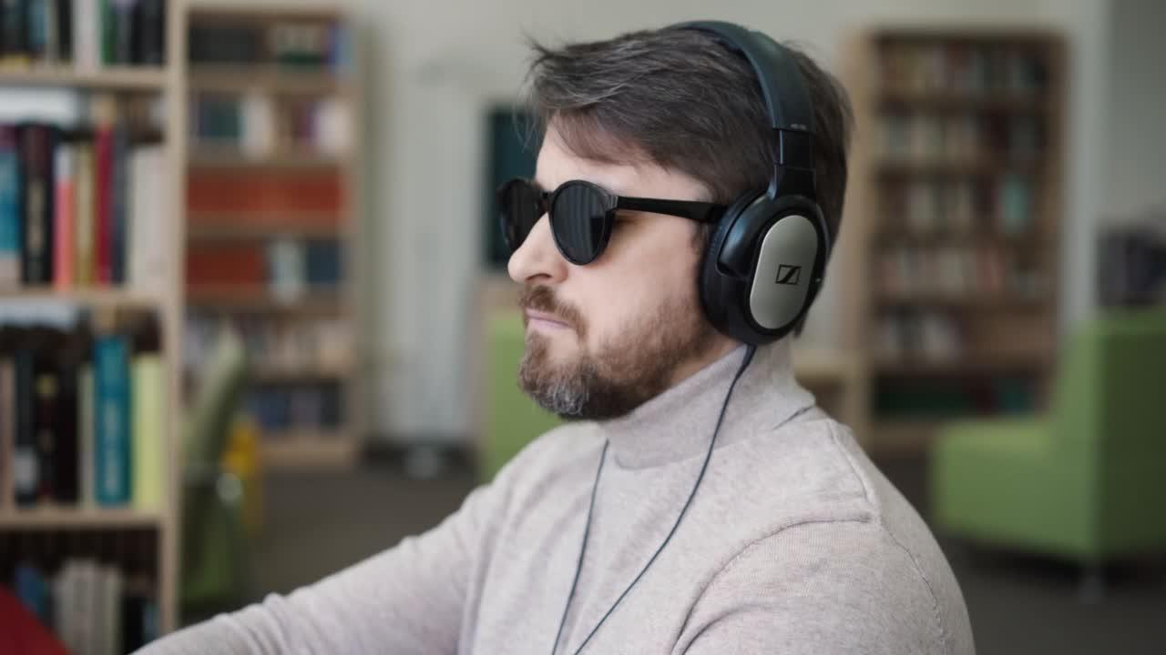
Group 24
Voice Based Email for the Blind
Group Members:
PRAGYA YADAV (MT22116)
RAJAT RELKAR (MT22054)
VEDANT GODBOLE (MT22088)
SAKSHAM SACHWANI (MT22120)
SHIVAM PANDEY (MT22123)

Slide 2

8 MILLION
Given the alarming rates of blindness in India, there is a huge scope for assistive helping aids.
At 8 million, India has the world’s largest blind population.
Therefore, we can leverage the use of machine learning tools to improve their social interactions.
https://www.firstpost.com/health/at-8-million-india-has-the-worlds-largest-blind-population-nearly-half-of-it-was-preventable-10529251.html

Slide 3


OVERVIEW
Motivation
Introduction
Scope
Problem Statement
Approach
Literature Review
Novelty
Methodology
System Prototype
Potential Contribution

Slide 4

MOTIVATION
Given that India has the highest number of visually impaired individuals in the world:
It is crucial to develop assistive technologies that leverage machine learning to enable them to access emails and communicate via speech inputs, thus improving their quality of life and social interaction.

Slide 5



INTRODUCTION
An alternate method of email interaction using speech.
Improving the accessibility by being useful to a wide variety of users.
Practicality, and effectiveness of sending and receiving messages.

Slide 6





SCOPE
ACCESSIBILITY
CONVENIENCE
INNOVATION
MULTI-TASKING
This system can make email more accessible to people with visual impairments or other disabilities that make it difficult to read or type.
For many people, speaking is faster and more natural than typing. Therefore this can can make it easier and more convenient to compose and send emails.
Opportunity to innovate in the email space, and potentially create a new product that attracts users who are looking for new and exciting ways to communicate.
Voice-based email systems can enable users to send emails while performing other tasks, such as driving or cooking.

Slide 7


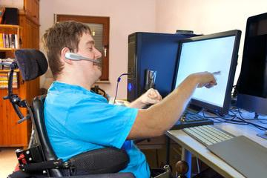

UPDATED PROBLEM STATEMENT
Our goal is to improve the conversion of speech data to text, as existing systems struggle to do so.
The system is a complete email management system because it includes features like email navigation and management.
Users with typing issues, disabilities, limited skills or knowledge, and elderly people can also benefit from voice-based email systems as it offers a user-friendly and straightforward communication method.

Slide 8







APPROACH
Users can interact with the Voice based email system and the user interface created using Django framework.
User's details will be captured using Google speech to text and then their inputs would be validated by prompting them to confirm after each vocal input.
After the user’s credentials have been validated, he/she will be redirected to the main menu where the user will be prompted to select an option from a list of options.

Slide 9
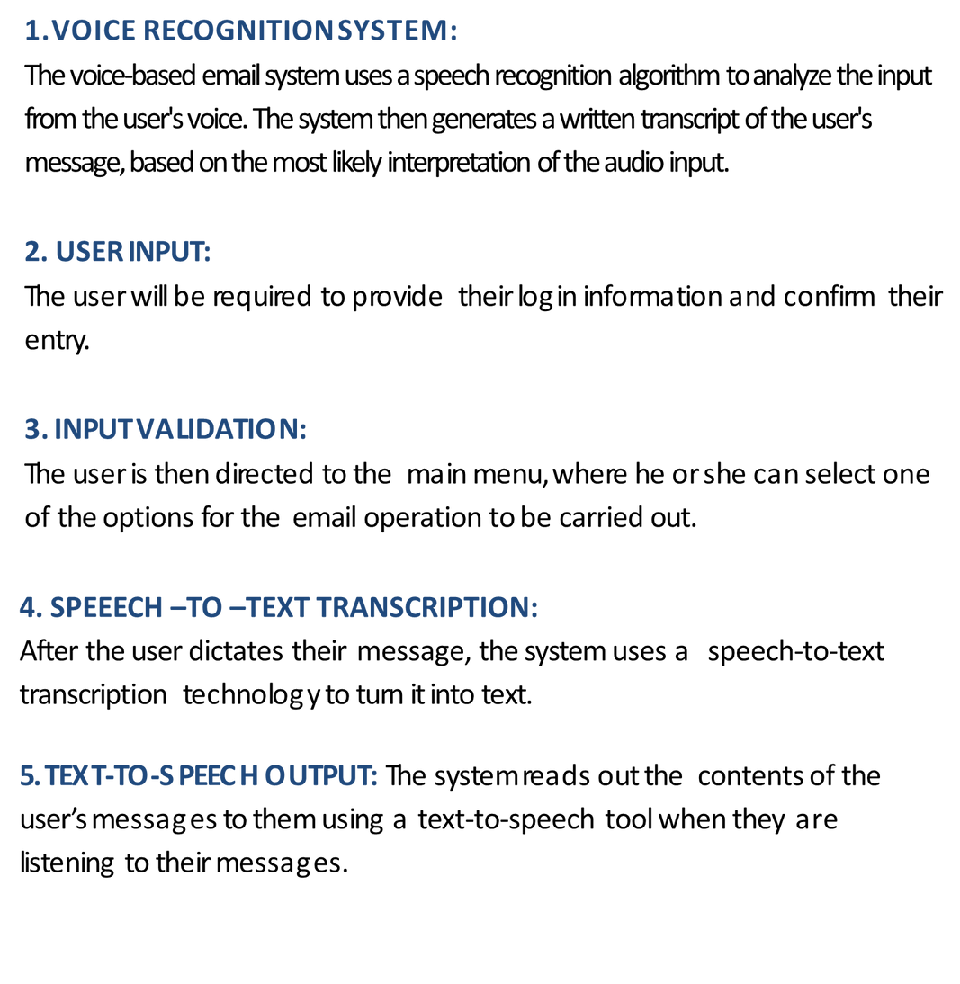
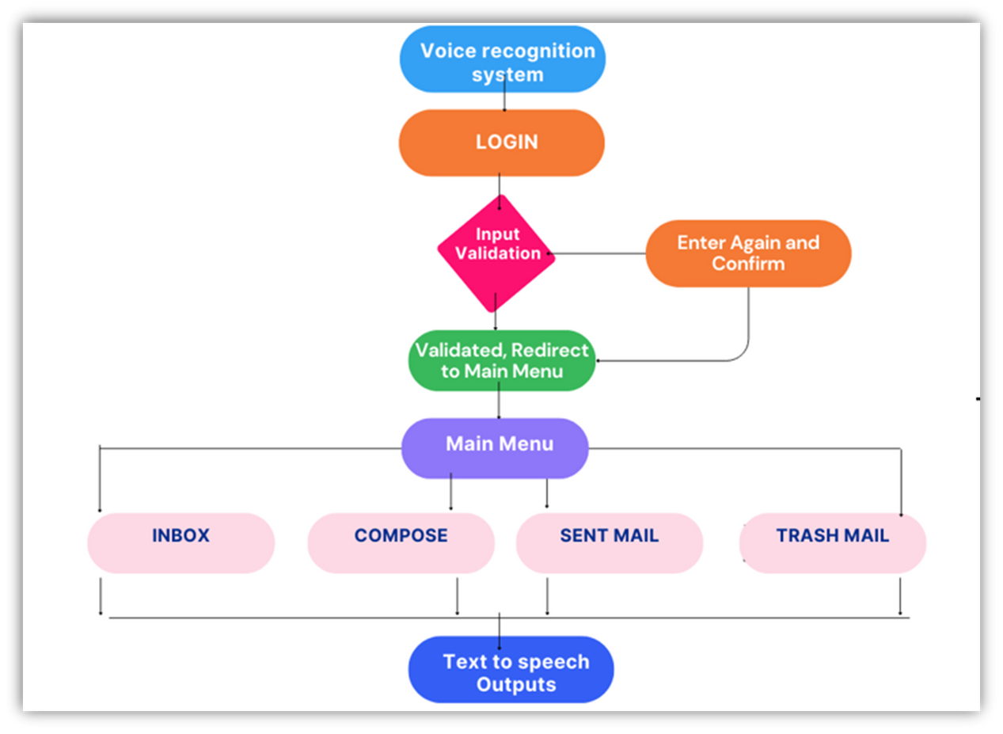
METHODOLOGY

Slide 10
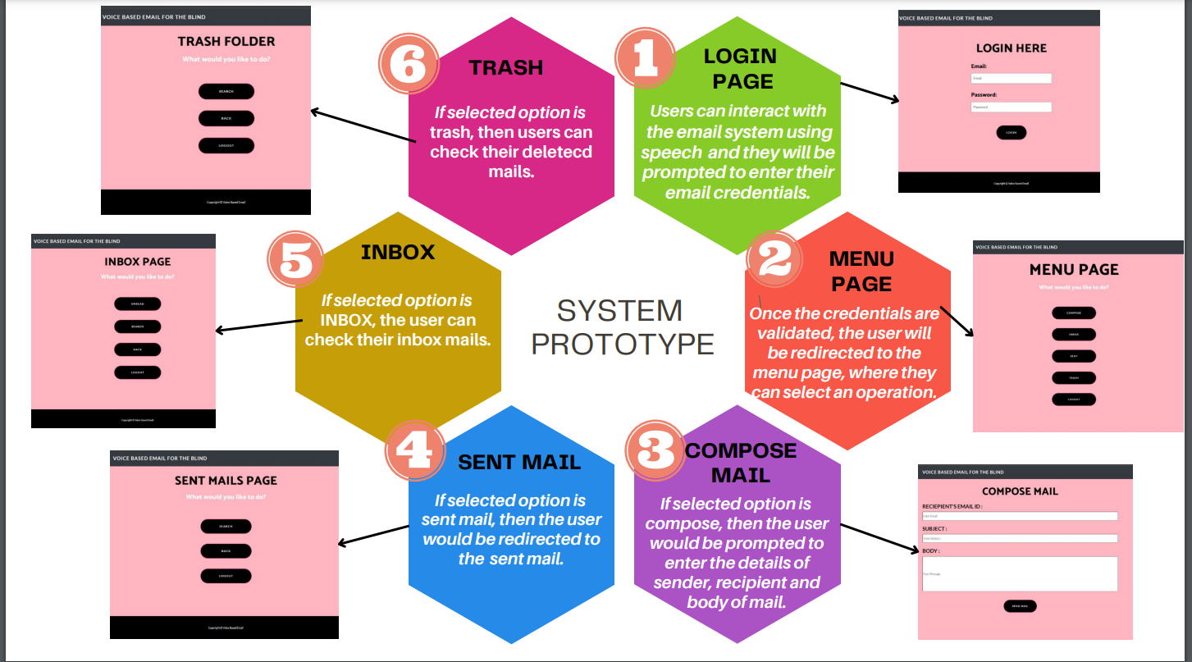

Slide 11

IR in Action: How Our Project Uses Information Retrieval"
IR is used for both searching and spam filtering capabilities, enhancing the system's overall usefulness and accessibility.
IR in voice-based email systems is utilized for spam filtering through machine learning algorithms that analyze incoming email messages' content and metadata to identify spam patterns, followed by appropriate action based on user preferences.

Slide 12
IR in Action: How Our Project Uses Information Retrieval"
IR Systems can support multilingual languages through language identification and query expansion techniques. Language identification can be achieved through machine learning algorithms, or dictionary-based approaches. Query expansion can help retrieve more relevant results and overcome language barriers in IR.
IR can be utilized to offer personalized email recommendations based on the user's past behavior, such as opened or responded emails, to enhance the voice-based email experience for the blind.

Slide 13



NOVELTY
NLP technology can be used to understand the user's intent and retrieve or compose emails through speech-to-text conversion algorithms.
Personalized voice commands can be used in a voice-based email system for blind users to create customized commands for performing different tasks within the email application, making the interaction more intuitive and tailored to their specific needs and preferences.

Slide 14
NOVELTY
Intelligent inbox organization uses Machine learning algorithms, such as decision trees or neural networks, to automatically categorize and prioritize emails based on a blind user's past email interactions and preferences, making it easier for them to navigate and manage their email without the need for manual sorting.
Multilingual language support in a voice-based email system enables the system to recognize and respond to multiple languages, allowing users who speak a language other than the default language to manage their email, and improving accessibility and usability.

Slide 15
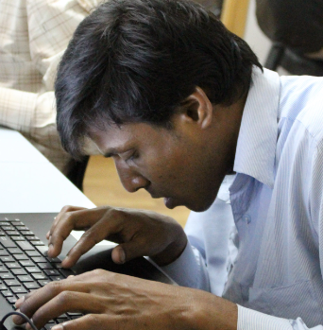
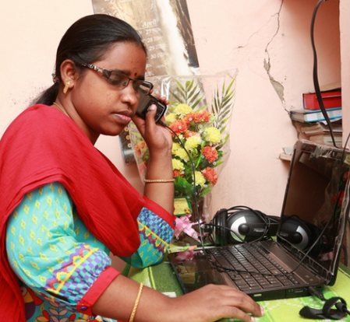


POTENTIAL CONTRIBUTION
01
02
Voice-based email can help close the digital divide and improve communication for blind people by offering a more user-friendly and accessible interface.
Moreover, voice-based email systems can be created with accessibility features that are specifically catered to the requirements of blind users, text-to-speech and speech-to-text capabilities, and other features.
03
04
Voice-based email systems can aid in promoting greater social and economic inclusion by making it easier for blind people to access and utilise email. As a result, they are better able to connect with friends, family, and coworkers and can take advantage of educational and career opportunities.
Our research will contribute to the growing knowledge in voice-based email systems for the visually impaired, promoting accessibility and inclusivity.

Slide 16


LITERATURE REVIEW
The research presents a method for improving email accessibility for those with visual impairments and underlines the possibility of expanding the system to accommodate other disabilities, but it also emphasises the need for a more complete email management platform.
The article presents a system that provides email services without requiring a keyboard, using speech recognition and mouse clicks, but implementing speech-based login verification raises concerns for security and privacy, requiring additional security measures such as multi-factor authentication to prevent unauthorized attacks and access.
1
4
The article discusses a web application utilizing voice commands for users to access various services and prompts users to carry out actions, operating through different dashboard areas.
3
Those who are visually blind can access email using a desktop programme that integrates with the email client, however this requires may result in additional hardware expenditures for speech impairments.
2
The paper proposes a voice-controlled email system to provide visually impaired people with a more accessible and convenient way to access email, and also helpful to people with other disabilities.
5

Slide 17
References
[1] M. R. Pradhicsha , M. Vasanth , V. Renita , Dr. P. Lakshmi Harika, 2022, “Voice Based Mail System for Visually Impaired”, INTERNATIONAL JOURNAL OF ENGINEERING RESEARCH & TECHNOLOGY (IJERT) Volume 11, Issue 07 (July 2022).
[2] Belekar, Aishwarya & Sunka, Shivani & Bhawar, Neha & Bagade, Sudhir. (2020). Voice based E-mail for the Visually Impaired. International Journal of Computer Applications. 175. 8-12. 10.5120/ijca2020920657.
[3] H. D. Shah, A. Sundas and S. Sharma, "Controlling Email System Using Audio with Speech Recognition and Text to Speech," 2021 9th International Conference on Reliability, Infocom Technologies and Optimization (Trends and Future Directions) (ICRITO), Noida, India, 2021, pp. 1-7, doi: 10.1109/ICRITO51393.2021.9596293.
[4] Subhash S et al.,”Artificial Intelligence-based Voice Assistant” Fourth World Conference on Smart Trends in Systems,Security and Sustain-ability(World S4) 2020.
[5] P. A. Tiwari, P. Zodawan, H. P. Nimkar, T. Rotke, P. G. Wanjari and U. Samarth, "A Review on Voice based E-Mail System for Blind," 2020 International Conference on Inventive Computation Technologies (ICICT), Coimbatore, India, 2020, pp. 435-438, doi: 10.1109/ICICT48043.2020.9112539.

Slide 18





Thank you!

